Slide 1

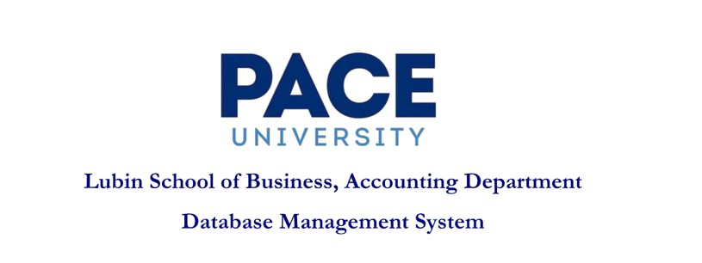




Project: Hotel Operations Management System
Team Members:
Dixit Prajapati dp81128n@pace.edu
Neha Mukunda nm21277n@pace.edu
Anitta Jaison aj61057n@pace.edu

Slide 2


Introduction
This project focuses on designing a relational database to manage hotel operations.
Objectives
Efficiently manage guest reservations, room availability,
and billing processes.
Eliminate overbooking and enhance the overall guest experience.
Facilitate quick and accurate data retrieval through optimized queries.

Slide 3



Problem Statement
Vision:
To empower hotel operators with a scalable, secure, and automated information system that enhances guest satisfaction, reduces manual overhead, and supports data-driven decisions across all departments.
Mission:
To develop a reliable and efficient database-driven hotel management system that simplifies booking, billing, service delivery, and reporting while ensuring data integrity and operational accuracy.

Slide 4



Entities & Relationships
Key Entities
Guests: Stores guest details like name, contact, address, ID, and date of birth.
Rooms: Tracks room number, type, rate, and assignment status.
Bookings: Connects guests to hotels and rooms with check-in and check-out dates.
Invoices: Manages billing details such as total amount, payment method, and payment status.
Hotel Services: Defines services like laundry, cleaning, and room service.
Relationships
One-to-Many: Guests → Bookings | Bookings → Invoices | Staff → Service Usages
Many-to-Many: Bookings ↔ Rooms (via booked_rooms) | Bookings ↔ Hotel Services (via hotel_service_usages)

Slide 5
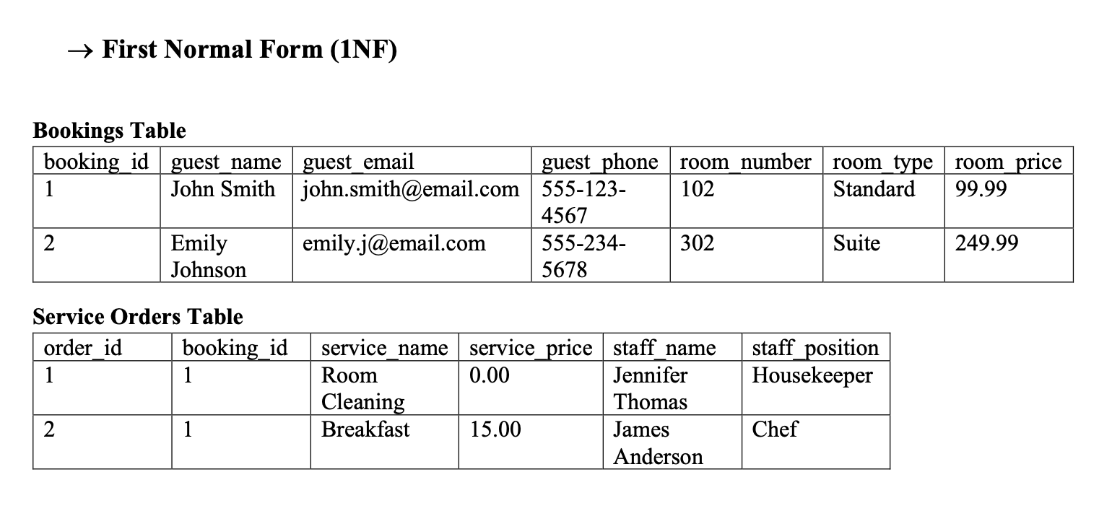
Database Normalization

Slide 6
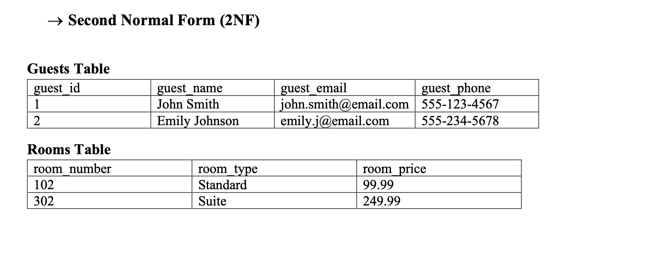
Database Normalization

Slide 7
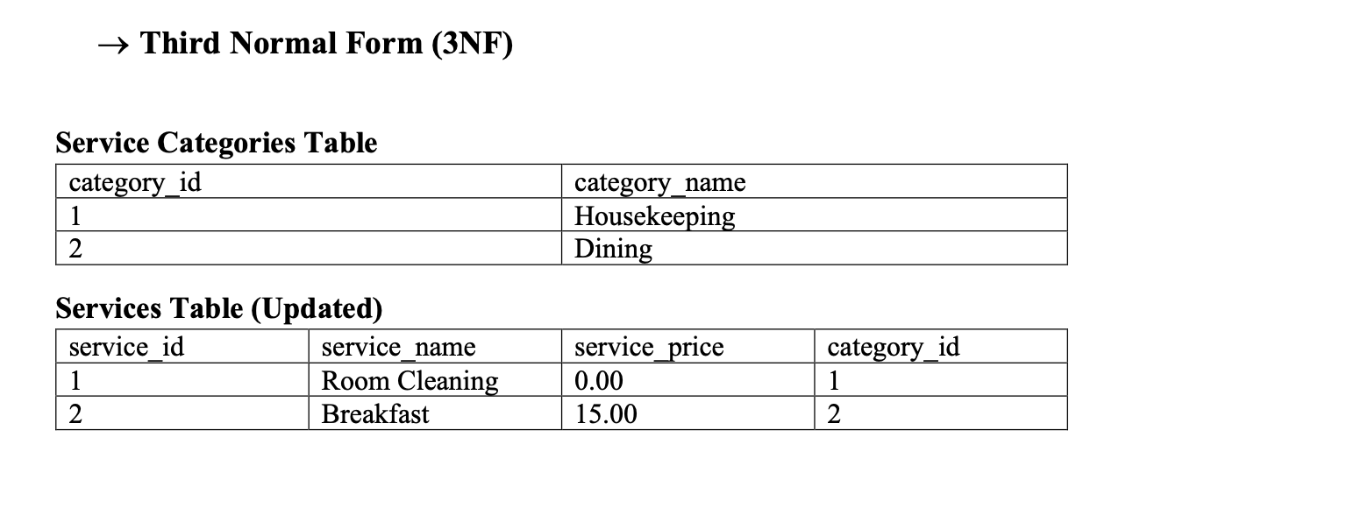
Database Normalization

Slide 8
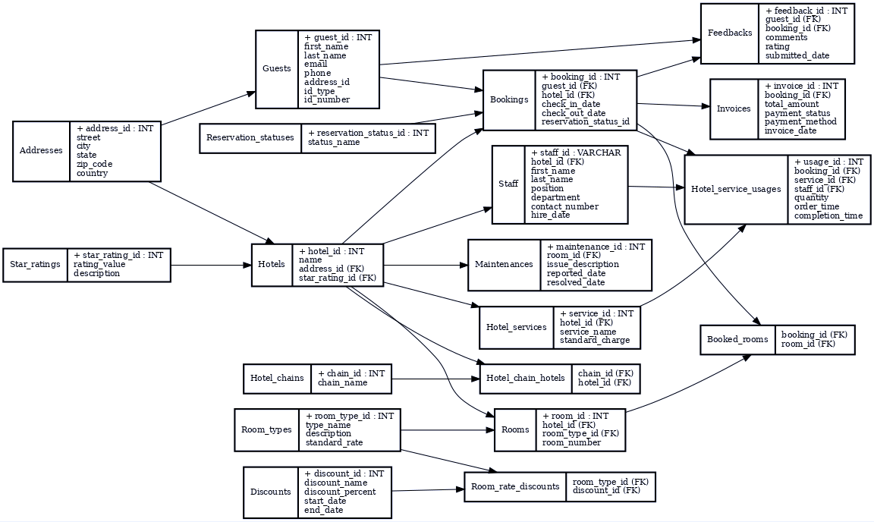
ER Diagram

Slide 9



SQL Query

Slide 10
SQL Query

Slide 11
SQL Query

Slide 12
Thank you

